Slide 1





TOPIC: TOward Perfect InfluenCe Graph Summarization
Lei Shi, Sibai Sun, Yuan Xuan, Yue Su,
Hanghang Tong, Shuai Ma, Yang Chen

Slide 2
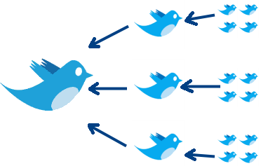


Example of Influence Graphs
Initial
Tweet
Re-tweets
Re-tweeting Graph
Source
Paper
Citing papers
Paper Citation Graph
Notes:
Initially a small diagram showing the source paper/news and its directed linkage, then the full picture, state the challenges in understanding large influence graphs

Slide 3
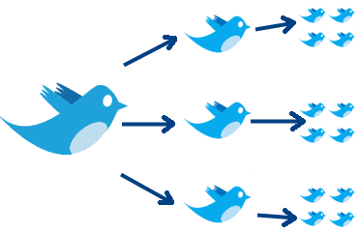
Example of Influence Graphs
Initial
Tweet
Re-tweets
Social Influence Graph
Source
Paper
Citing papers
Citation Influence Graph
(Non-tree)
Notes:
Initially a small diagram showing the source paper/news and its directed linkage, then the full picture, state the challenges in understanding large influence graphs

Slide 4
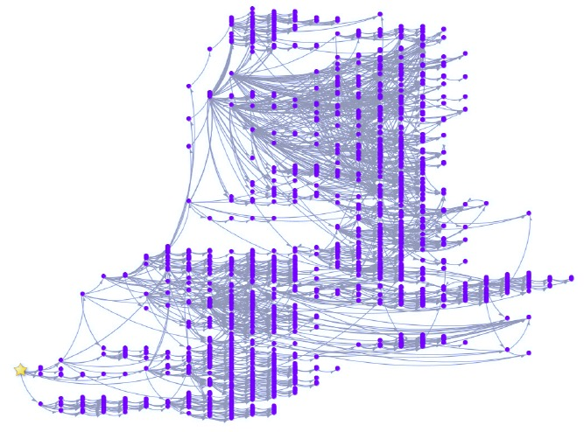
Example of Influence Graphs
Source
Paper
Citation Influence Graph
Real-world Case
(>> 2509n/5256e)
Scalable and high-quality layout algorithm
Overlapping nodes and crossing edges
Visualization Challenges:
Notes:
Initially a small diagram showing the source paper/news and its directed linkage, then the full picture, state the challenges in understanding large influence graphs

Slide 5
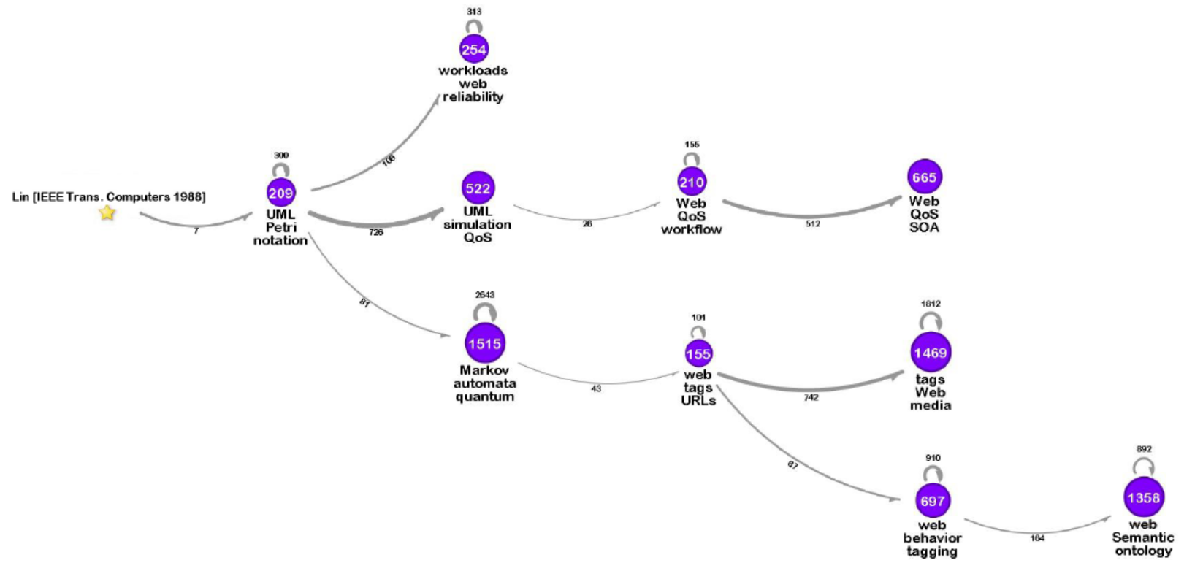
Influence Graph Summarization (IGS)
Clusters
(center: #size;
below: content summary)
Source node
(paper)
Flow
(below: flow rate)
See Table 1 for more information
Notes:
Show a summarization of the paper citation influence graph (TKDE’15), introduce the clusters, flows, summarizations

Slide 6
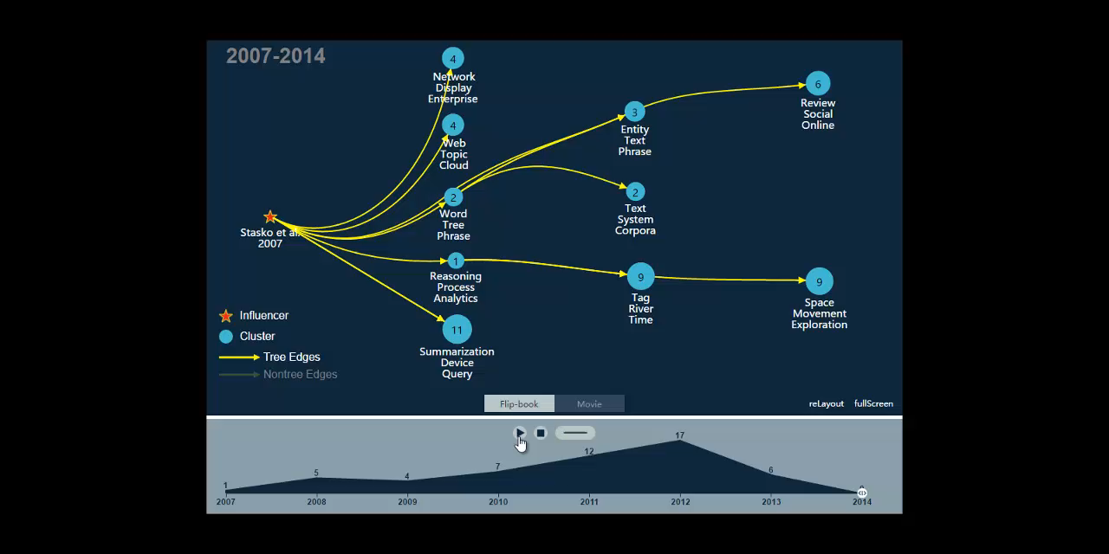
Why Important – Live Case on Citation Influence Graph
Notes:
Show the movie, understand the influence propagation: 1) the overall picture; 2) the dynamics

Slide 7
Outline
Related Work and Flow-based IGS Objective
Motivating Problem
New Perspective on the IGS Objective
Proposed IGS Methods
Optimal IGS
Dynamic IGS
Evaluation
Flow-based Objective
Scalability
Case and User Experiment
Conclusion

Slide 8
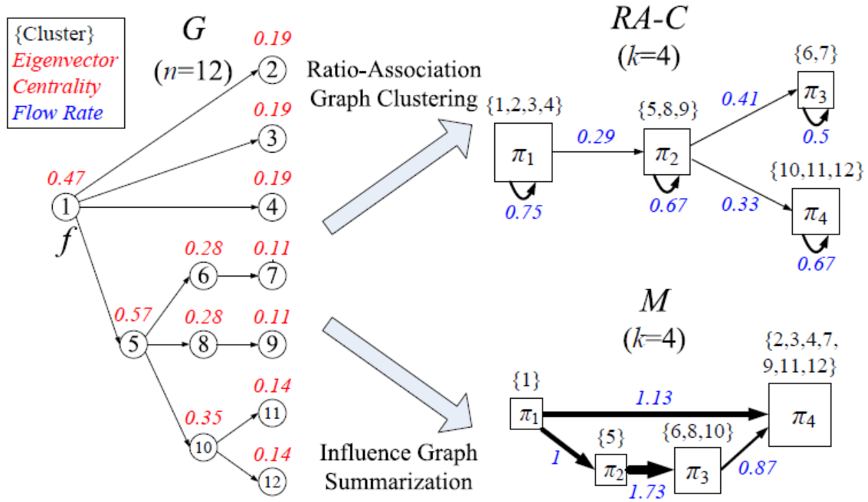
Related Work – Not Targeting IGS
Graph clustering [Newman’04], compression [Shi’13], summarization [Tian’08][Navlakha’08][Zhang’10], spectral sparsification [Batson’13]
Lossless graph compression still leads to a high visual complexity
Most other high-level abstractions fail to reveal influence patterns
Illustrative/Comparative Example
Influence graph analysis
Social influence maximization [Kempe’03][Tang’09][Bond’12] : do not consider summarization and visualization, on “who” but not “how”
Influence network sparsification [Mathioudakis’11] [Mehmood’13]: explicitly using the underlying social network

Slide 9
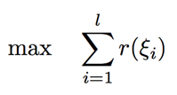
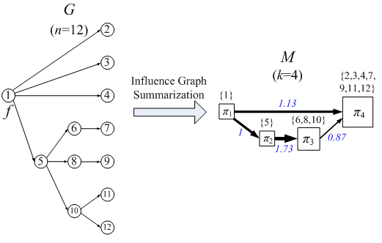
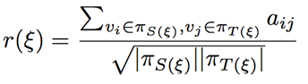
Related Work – Flow-based IGS [TKDE’15]
Define Influence Graph Summarization (IGS) problem
Given: 1) maximal influence graph G from the source node f; 2) k, the number of node clusters in the summarization M; 3) l, the number of flows in M;
Compute: 1) a k-clustering of graph G; 2) l top flows in the summarization M;
By optimizing the flow rate maximization objective:
Flow rate is defined by the size-normalized connection strength
flow rate annotated in blue

Slide 10
Limitation of Existing IGS Algorithms
Optimization of IGS objective is not strictly guaranteed
Matrix decomposition based method
Approximation of IGS objective is proved
Visual summarization quality
Only consider the IGS computation given one static k
Dynamic IGS scenario with increasing/decreasing k
High computational cost for large influence graphs
Complexity of the original SymNMF iterative solver, at least O(n²)

Slide 11
Motivating Problem of This Work
Design new algorithms for the IGS problem to achieve:
Optimality
Theoretically optimal IGS solution
Scalability
Close to linear computational complexity for large influence graphs
Flexibility
Solve dynamic IGS problem

Slide 12
Optimality of IGS Problem
Optimality
Theoretically optimal IGS solution
Scalability
Close to linear computational complexity for large influence graphs
Flexibility
Solve dynamic IGS problem

Slide 13
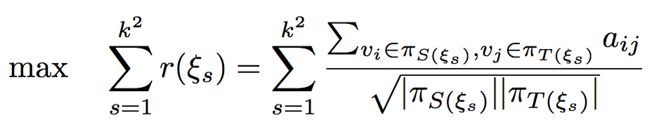
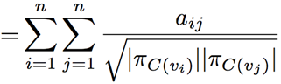
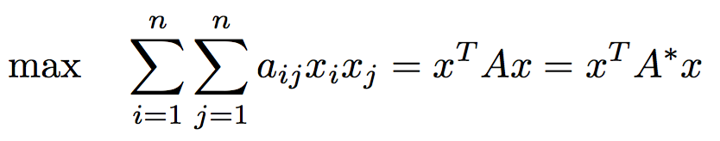
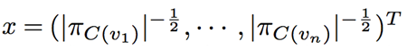
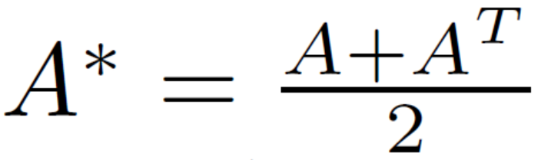
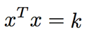
New Perspective on IGS Objective
Consider the objective under l = k²:
This can be written as the quadratic form:
where
Subject to the constraint on x for a valid k-clustering
e.g., the size constraint
and

Slide 14
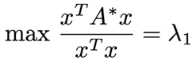
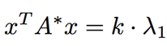
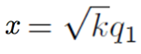
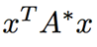
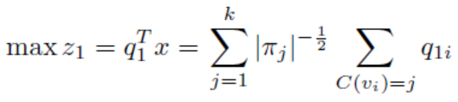
Analysis of the Optimality
By the min-max theorem, the theoretical optimality is achieved when:
where λ₁ is the largest eigenvalue of A*, q₁ is the largest eigenvector of A*
This optimality can not be achieved because of the constraint on x
We propose to optimize the largest component of in the eigen-decomposition. The objective becomes:
where q_{1i} is the ith component of the largest eigenvector of A*
Performance guarantee by a lower bound in the IGS objective can be achieved by only optimizing the largest component

Slide 15
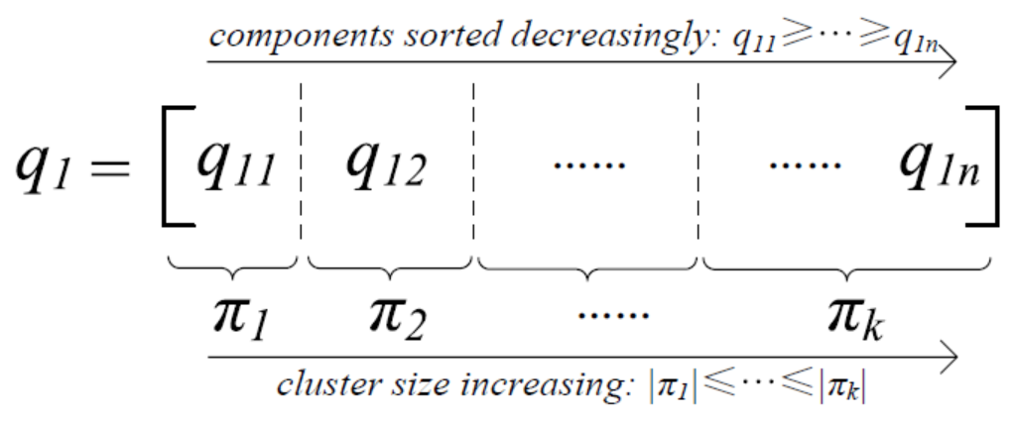
Equivalence to the segmentation problem
Maximizing the objective on the largest component is equivalent to solving a k-segmentation problem on the largest eigenvector of A* (sorted decreasingly}
Implications: also equivalent to group the graph nodes by their eigenvector centrality similarity, e.g., the red label in the right figure:

Slide 16
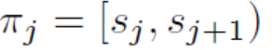
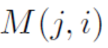
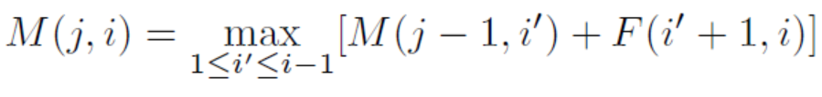
Optimal IGS Algorithm: DP for k-Segmentation
Dynamic programming (DP)
Define the gain by a cluster by
Define the objective of segmenting a sequence of length i into j clusters by
The optimization of objective can be computed iteratively from i=1, j=1 by

Slide 17
Scalability of IGS Problem
Optimality
Theoretically optimal IGS solution
Scalability
The theoretically optimal DP algorithm has a O(n²k) computational complexity
Flexibility
Solve dynamic IGS problem

Slide 18
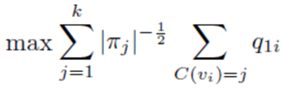
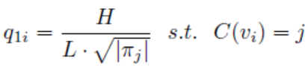
Scalable Algorithm - ISO
Iterative Stepwise Optimization (ISO)
According to the extended analysis on
Approximately we have
Computational complexity:
O(nlogn + n·I) (I: #iterations)

Slide 19
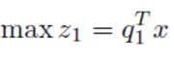
Scalable Algorithm - GCF
Greedy Curve Fitting (GCF)
According to the analysis on
This is the inner product of q₁ and x, equivalent to minimizing the angle between q₁ and x
Computational complexity:
O(nlogn + n·I) (I: #iterations)

Slide 20
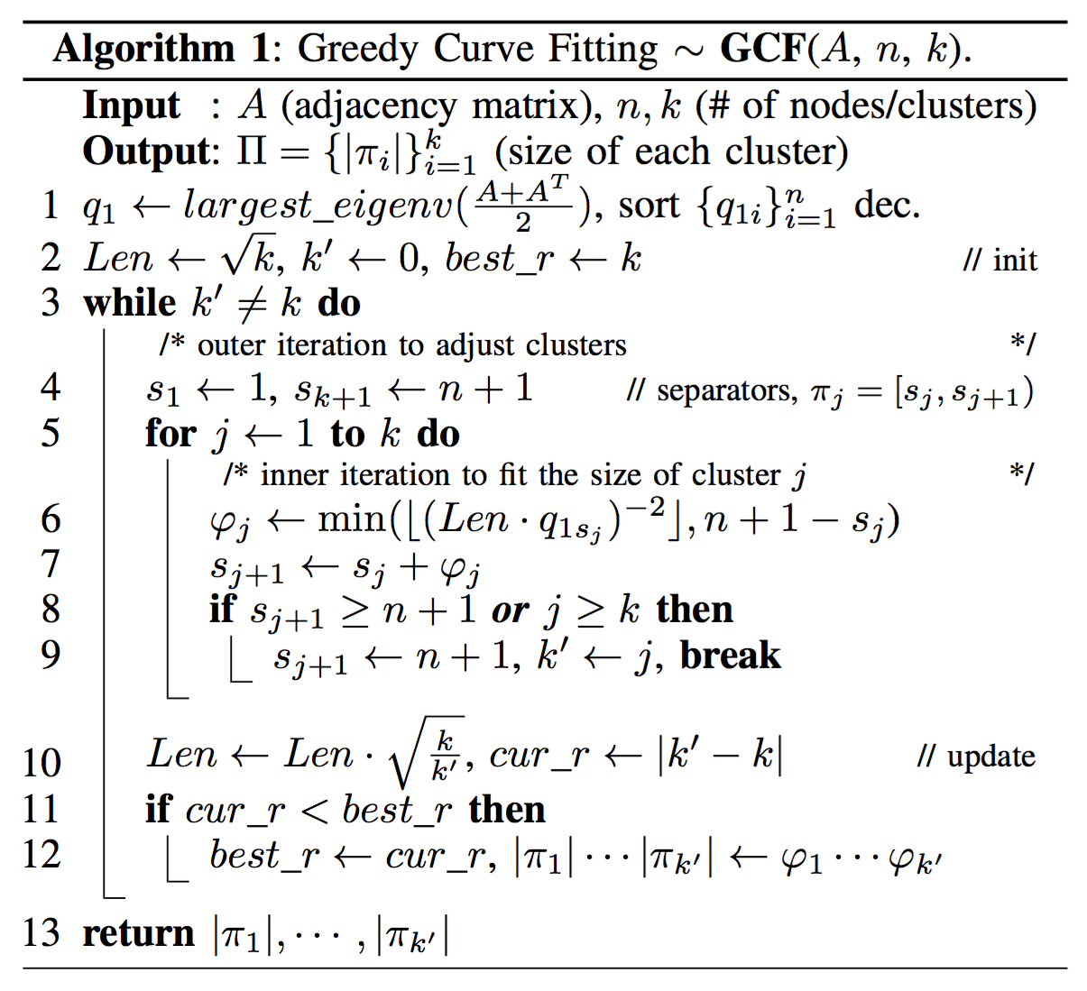

Slide 21
Flexibility of IGS Problem
Optimality
Theoretically optimal IGS solution
Scalability
Close to linear computational complexity for large influence graphs
Flexibility
Solve dynamic IGS problem

Slide 22
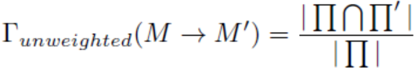
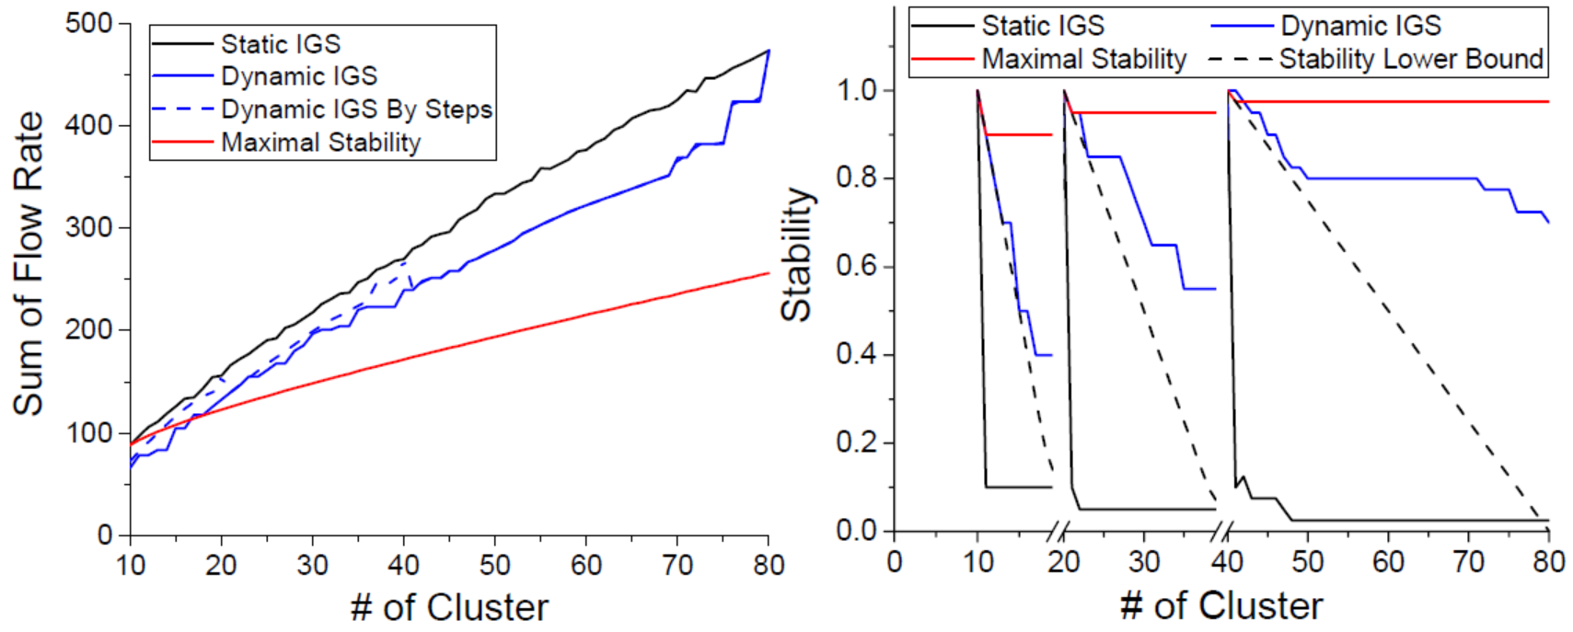
Dynamic Influence Graph Summarization
Optimize the IGS objective while maintaining stability of transition for a series of summarizations with varying k (#clusters)
Target the scenario of visual exploration on influence graph summarizations
Stability of transition for visualization:
The IGS objective and the stability of transition form a trade-off, there is no single optimality point for both metrics

Slide 23
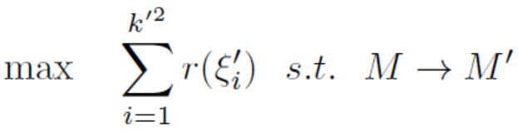
Feasible Dynamic IGS
Dynamic update rule for two summarizations with increasing k: clusters in the summarization with a smaller k (larger clusters) can only split but not merge in transition to the summarization with a larger k’ (smaller clusters)
This is a loosed requirement in maximizing the stability of transition, with a lower-bound stability guarantee of 2 - k’/k
Support a series of summarizations larger than two, and/or with decreasing k
Dynamic IGS problem
Given: 1) maximal influence graph G from the source node f; 2) M - the initial summarization, k - the number of node clusters in M; 3) k’ - the number of node clusters in the new summarization M’;
Compute: 1) the new k’-clustering of graph G;
By optimizing the constrained flow rate maximization objective:
obeys dynamic update rule

Slide 24
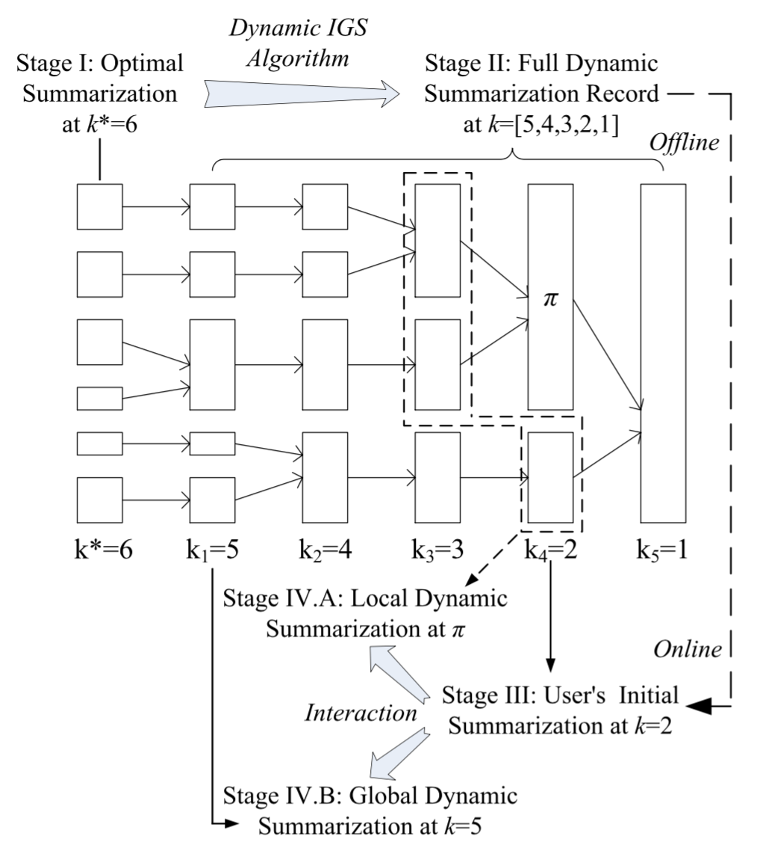
Dynamic IGS Solution and Algorithm
The bottom-up approach
Start from the finest-granularity summarization and merge node clusters agglomeratively
Enable the consistency between static and dynamic IGS algorithms
Support both local and global dynamic summarization
Meet the dynamic update rule
Algorithm – dynamic GCF
Work on the initial summarization graph M instead of the influence graph G
Theoretical consistency with the static GCF algorithm

Slide 25
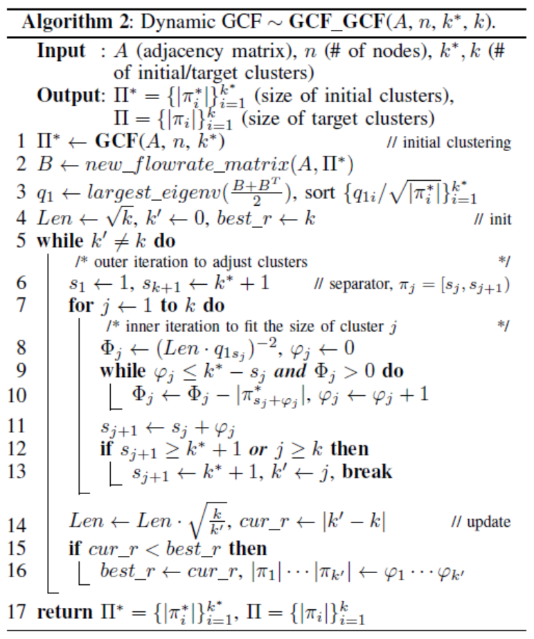
Dynamic IGS Solution and Algorithm

Slide 26
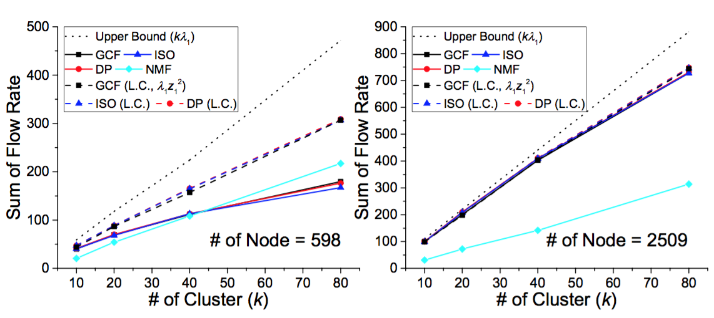
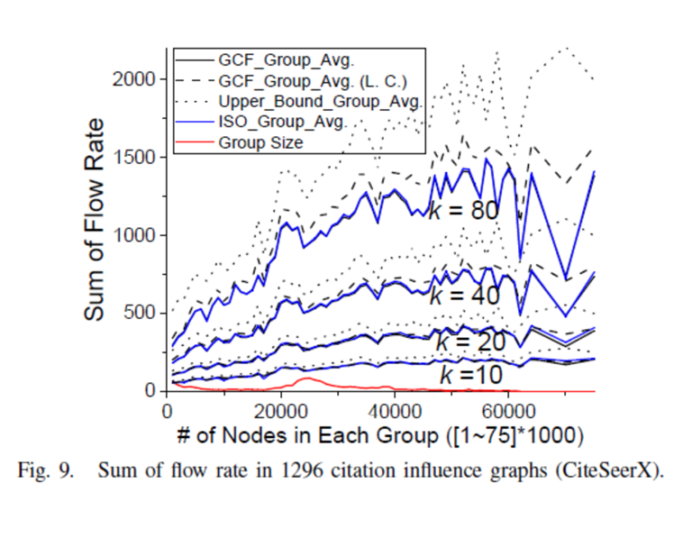
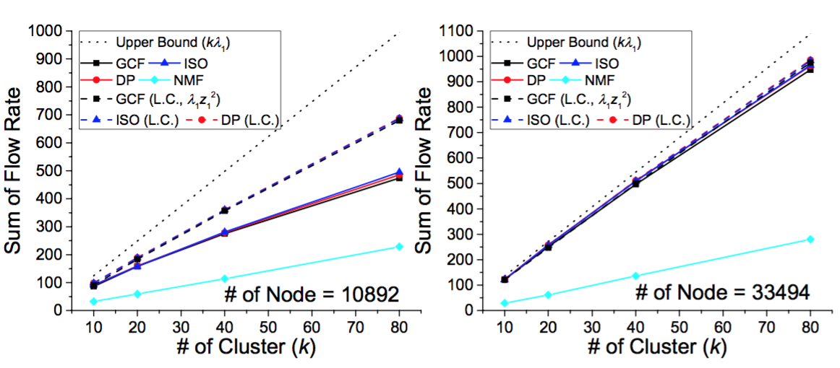
Evaluation – Static IGS Objective
IGS algorithms (GCF/ISO/DP) are much better than decomposition-based method in most cases
GCF/ISO perform close to DP
Largest components are close to or larger than the overall objective
A 50% lower-bound is guaranteed compared with the theoretically best objective

Slide 27
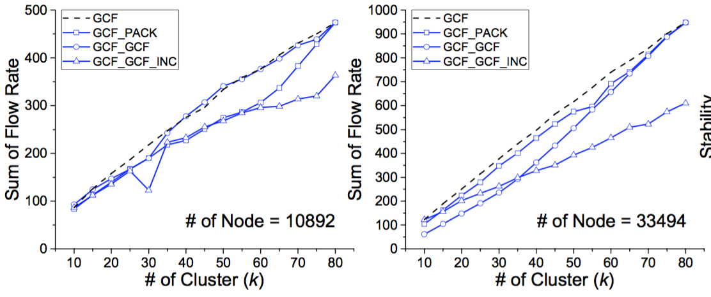
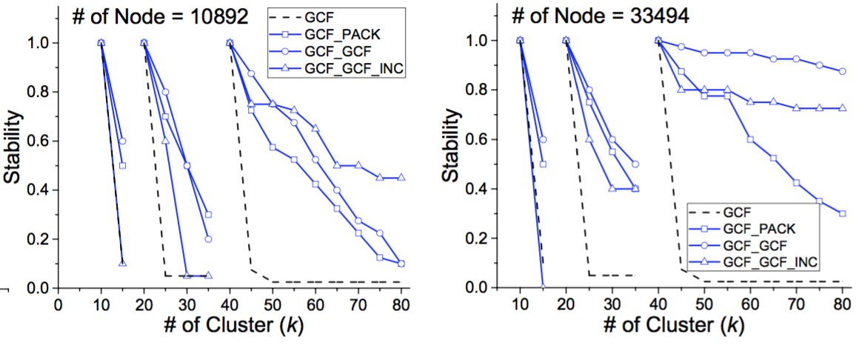
Evaluation – Dynamic IGS Objectives
Dynamic IGS algorithms achieve good trade-off: comparable IGS objective and much better stability of transition
Bottom-up dynamic IGS (GCF_GCF) is better than top-down dynamic IGS (GCF_GCF_INC)

Slide 28
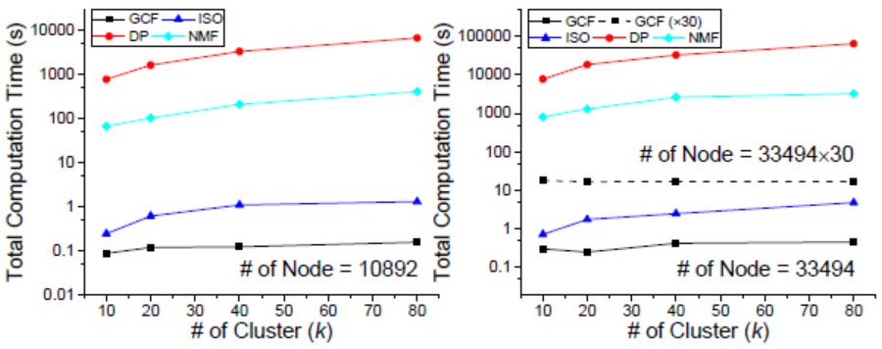
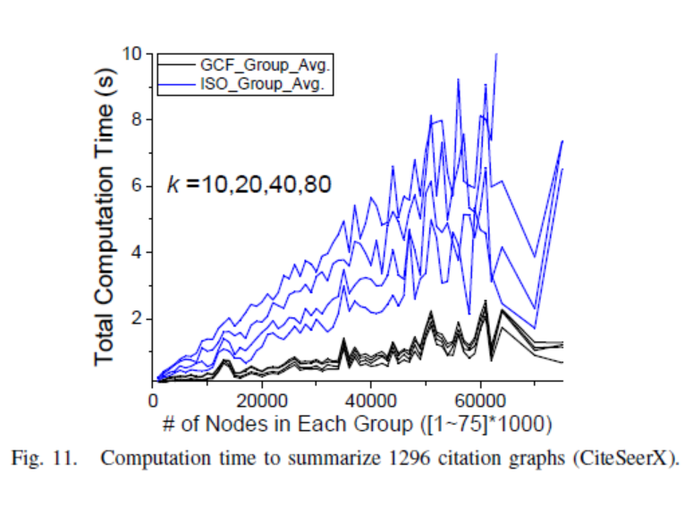
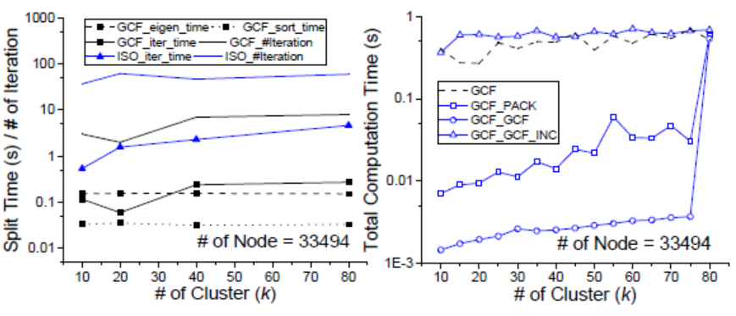
Evaluation – Algorithm Scalability
GCF>>ISO>>NMF>>DP
GCF algorithm suitable for large-scale influence graphs: 0.46 second to summarize 30000-node graphs, 16~18 seconds to summarize million-node graphs
GCF/ISO algorithm computation times grow slightly above linear
Dynamic GCF algorithm requires much less incremental computation time

Slide 29
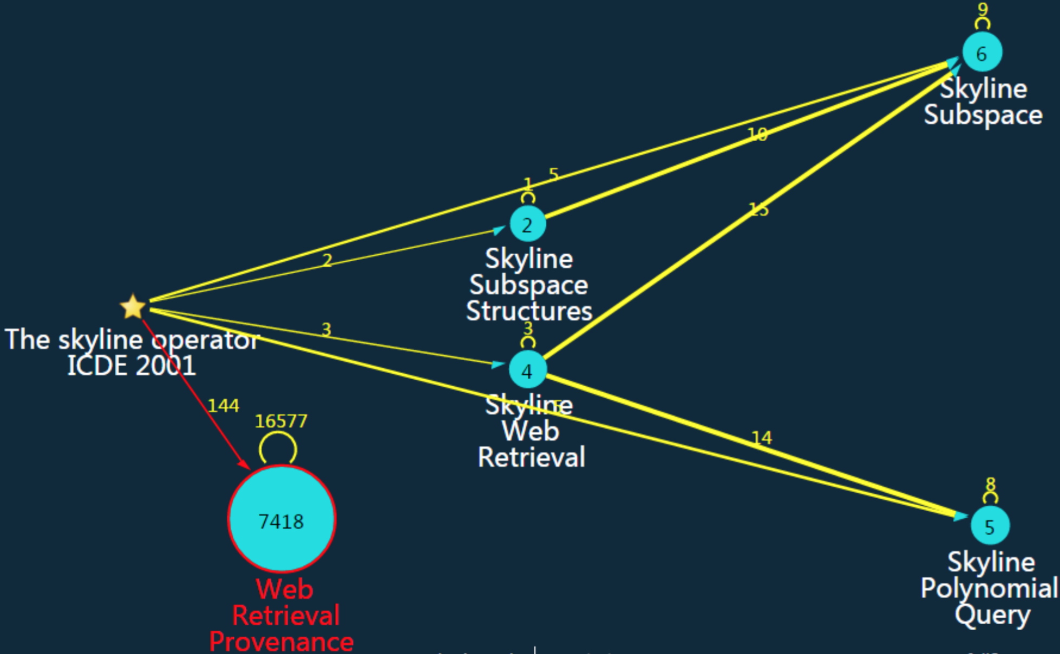
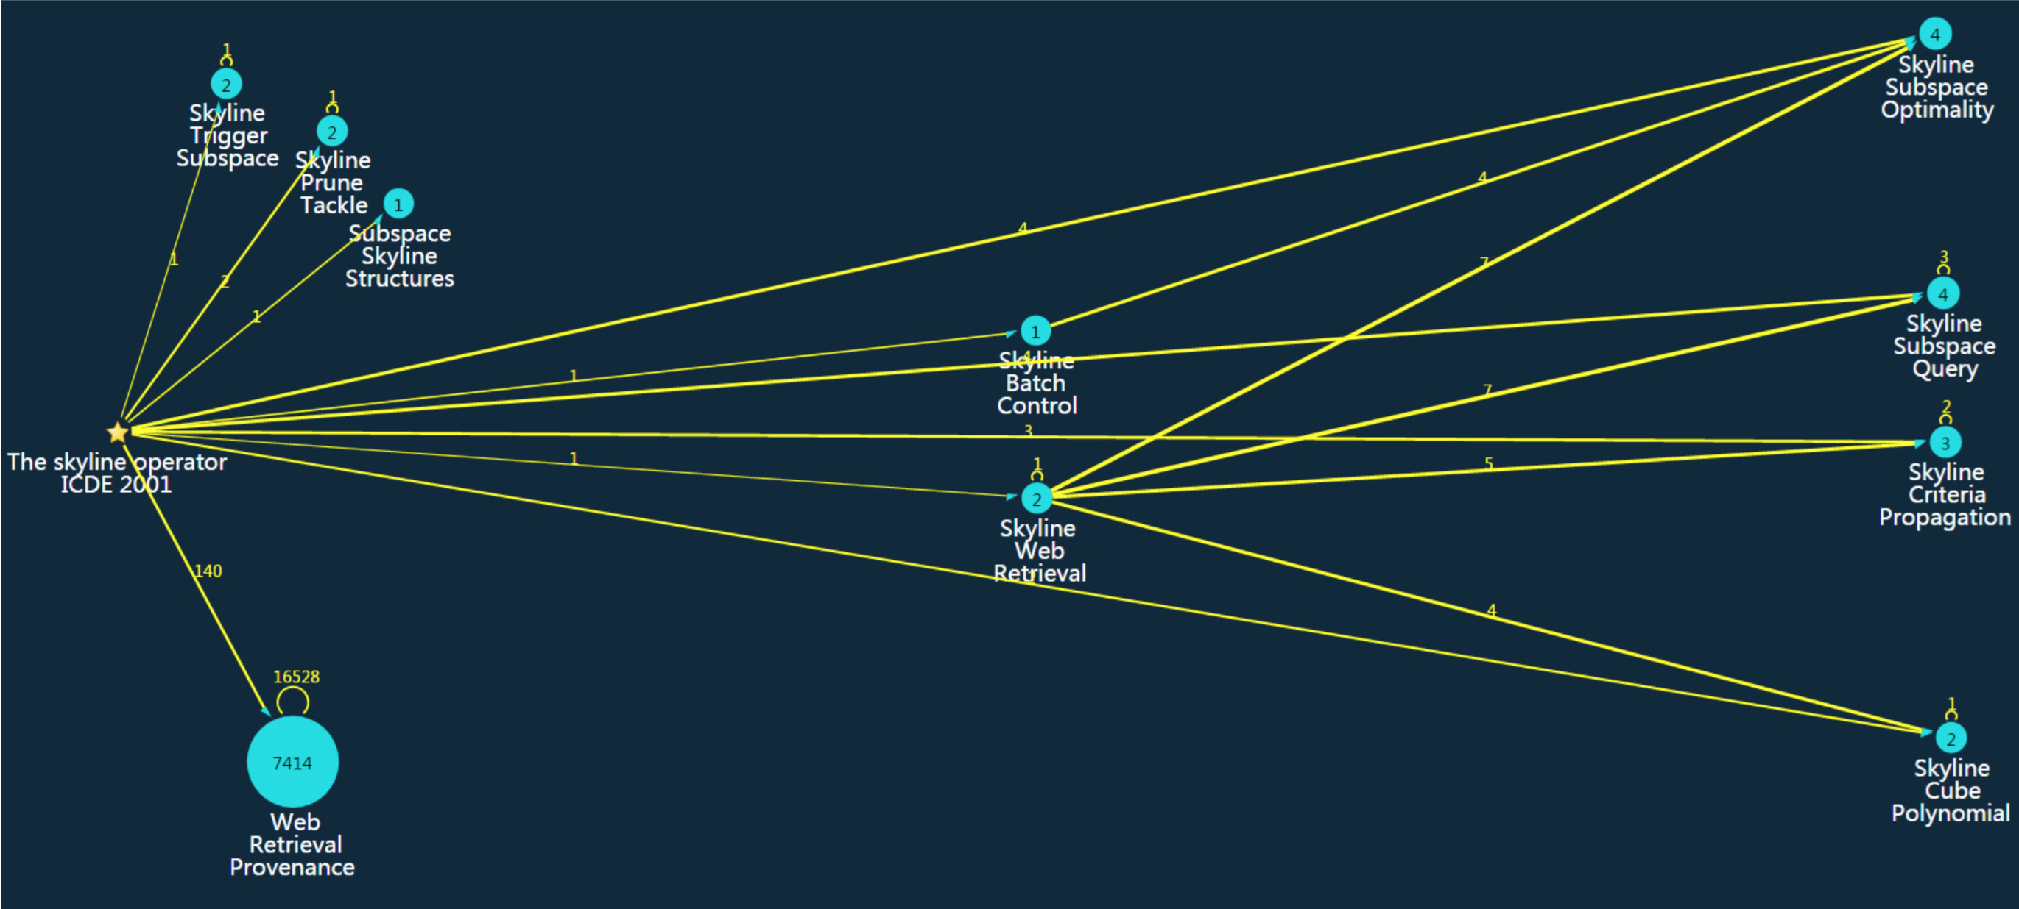
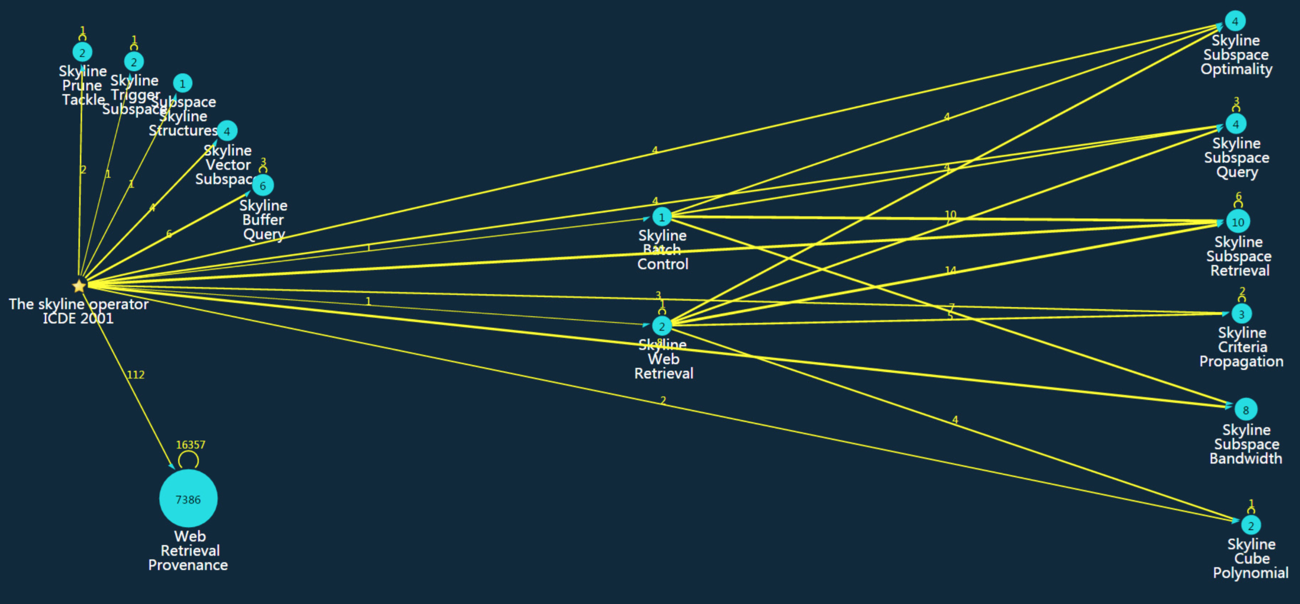
Case Study on CiteSeerX Dataset (GCF)
k=5
k=10
k=15

Slide 30
Case Study on CiteSeerX Dataset (NMF)
k=5
k=12
k=7

Slide 31
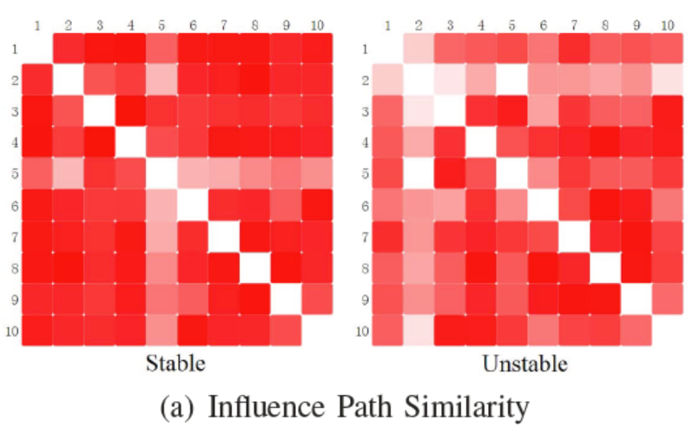
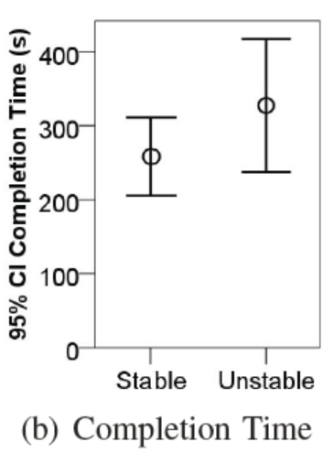
Evaluation – User Experiment
User performance in working with the dynamic IGS result
Comparing dynamic IGS of 5 incremental summarizations with those of independent static IGS results
Task: ask user to identify 4 influence paths from the source paper
Result
Dynamic IGS achieves larger path similarity across users (consistency) than the static IGS algorithm
Dynamic IGS requires less time cost and leads to smaller error compared with the static IGS

Slide 32
Conclusion
We propose a series of near perfect algorithms on the influence graph summarization problem:
Optimality
Theoretically solve the IGS problem
Design both exact and heuristic algorithms for IGS with performance guarantees
Flexibility
Propose the dynamic IGS problem
Extend the static IGS algorithm to the dynamic setting
Scalability
The best algorithm has a complexity of O(n lgn)
Scale to summarize million-node influence graphs in 16~18 seconds

Slide 33
Thank you! Questions?

